Slide 1
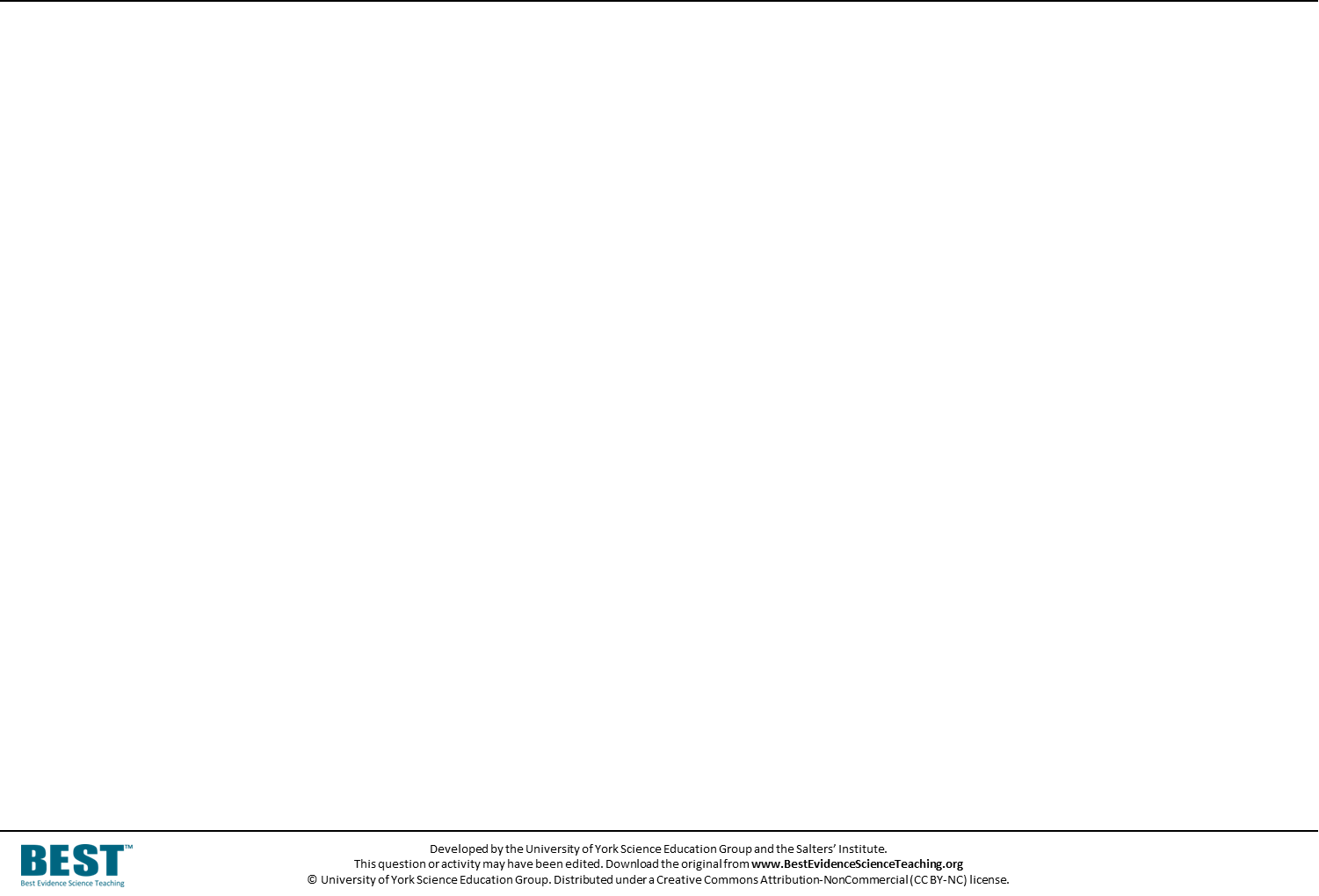
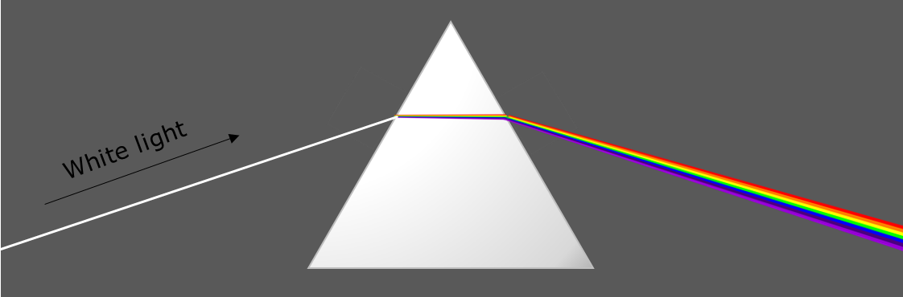

White stuff
White light contains all the colours of the spectrum.
In white light, white objects look white.

Slide 2


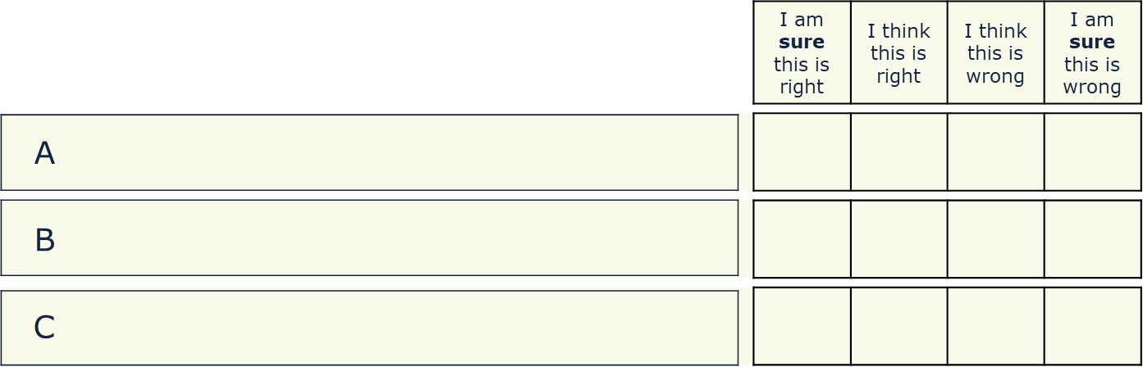
White stuff
Why do white objects look white in white light?
They reflect all the colours of the spectrum
They reflect no colours of light
White objects always look white

